Slide 1


ALTIQ Hospitality Analysis
Prepared by –
Shaikh Minhazuddin

Slide 2


Objective :
Highlight key metrics by city.
Analyze Explore revenue by property type.
Explore revenue by property type.
Find the platform wise booking share.

Slide 3
Key Performance Indexes
Total Successful Booking : 135k
Total Number of Guest : 274k
Totat Profit Generated : 2 Billion
Average Rating : 3.62
Highest Earning City : Mumbai
Top Booking Platform : makeyourtrip
Top Earning Branch : Altiq Exotica

Slide 4
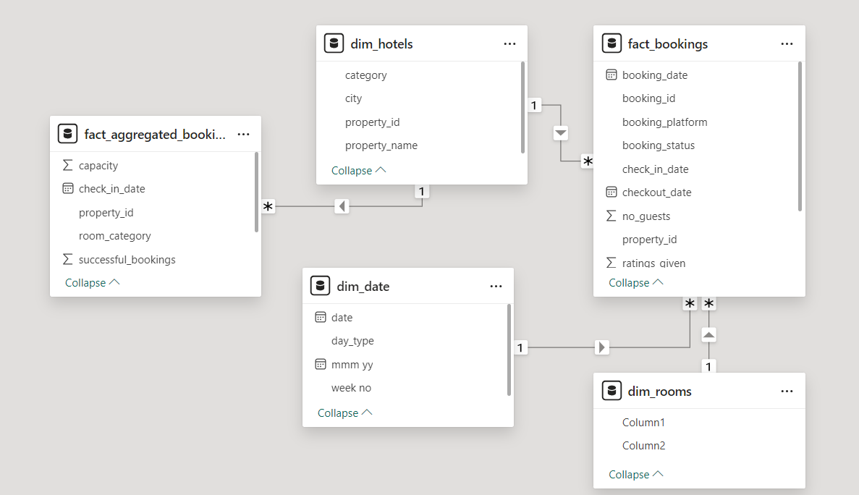
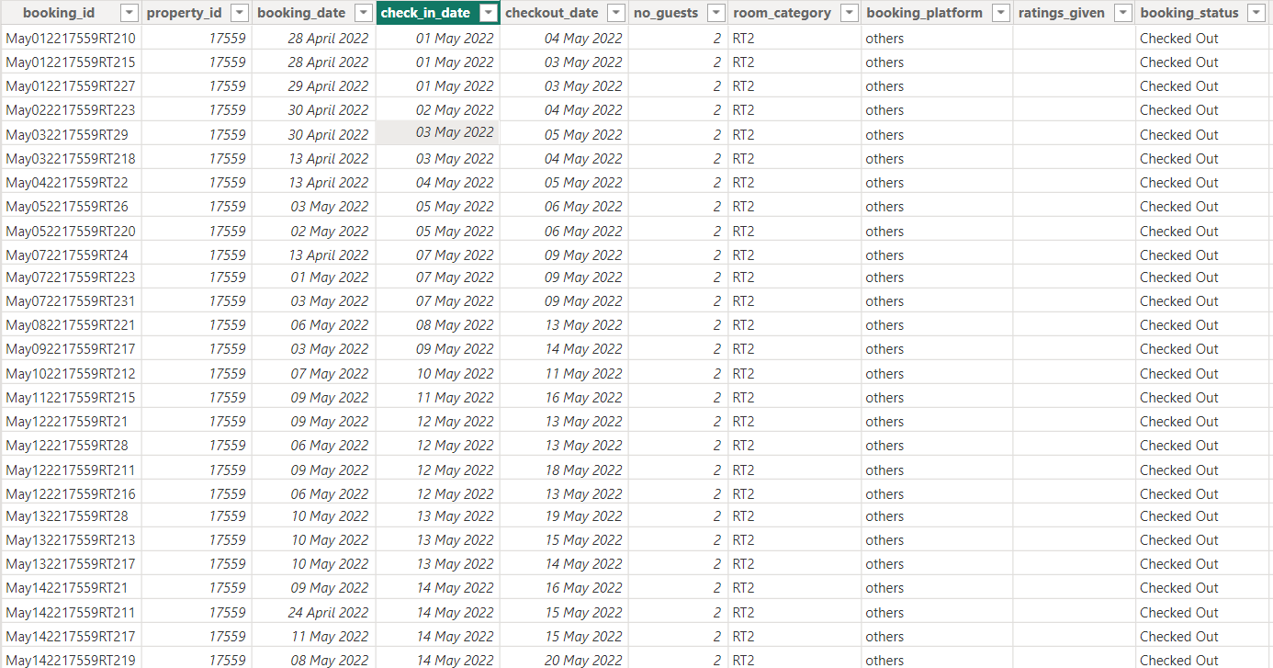
Dataset

Slide 5
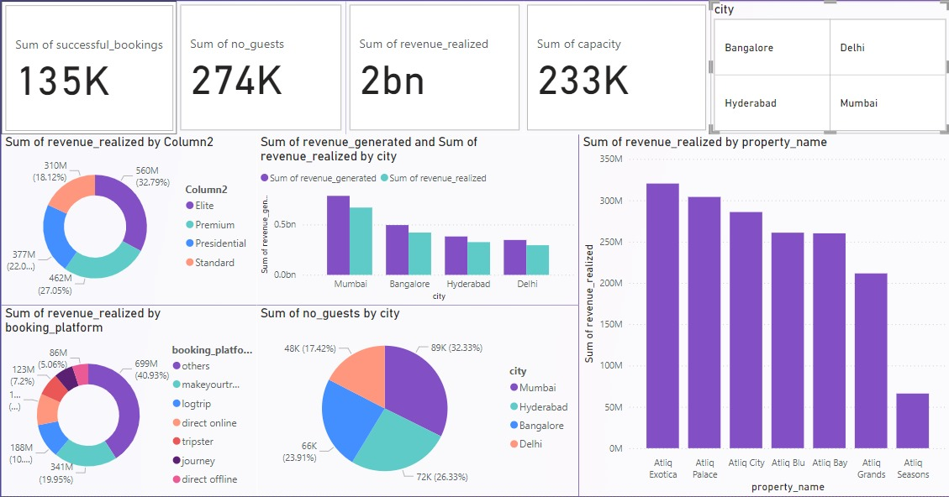
Dash Board -1

Slide 6
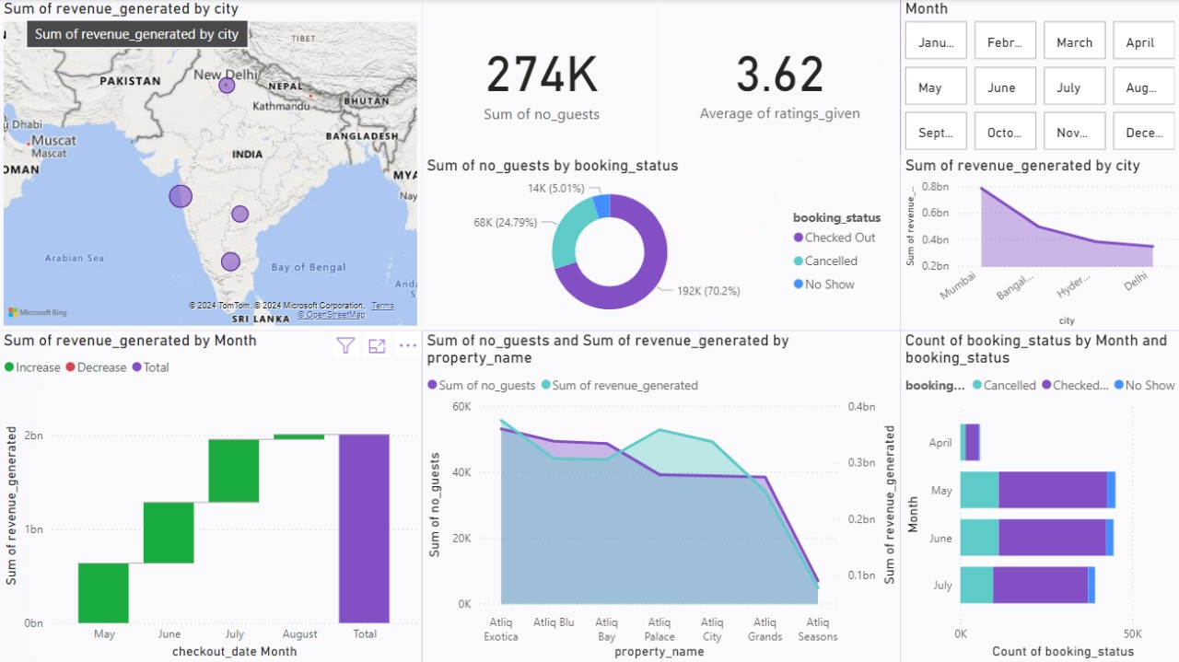
Dashboard -2

Slide 7
Thank You

